Slide 1


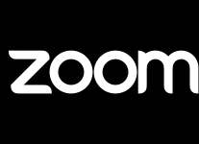
Predicting Zoom Stock Price
By Jing Fang, Minhua Wu, Nai Wang,
Shan Ali, Shruti Kapur, Zongying Mo

Slide 2
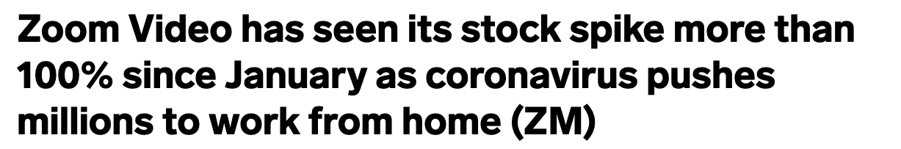

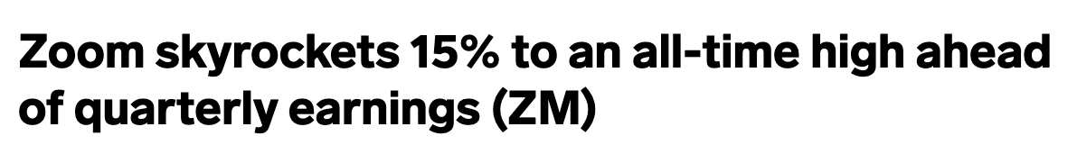
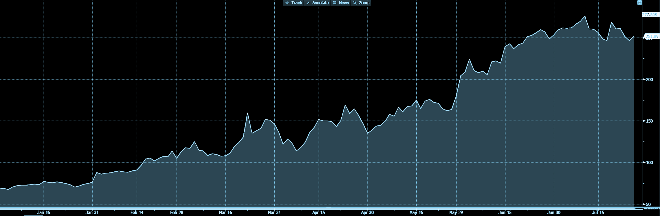
Motivation and Objective
The goal : Predict today’s opening price!
Zoom Price
Notes:
Zoom stock has exploded this year on expectations that the pandemic would drive paid subscriber growth for the video-conferencing service as the US went into a sweeping lockdown to curb the spread of COVID-19. In April, shares of the company popped when it said that its user base had reached 300 million.

Slide 3
Data Wrangling
Covid Data Indicators
Market Indicators
Daily Cases World | Covid indicator
Daily Cases USA | Covid indicator
Daily Deaths World | Covid indicator
Daily deaths USA | Covid indicator
Vix | Volatility Index : measure of the stock market's volatility
Treasury Yield 10 Yrs | Market indicator
Treasury Yield 13 week | Market indicator
Treasury Yield 10 Yrs 3 Mos Spread | Market indicator
NASDAQ Index | Market indicator
S&P 500 | Market indicator
Competitor Indicator
Cisco Open Price | Competitor(webEx)
Dependent Variable - Zoom Opening Stock Price
Notes:
We have used 11 quantitative variables across Covid data, market and competitor index to predict the Zoom stock opening price. We were limited by the Covid data in the number of data points in our sample - we have used data from January 1, 2020 to July 15, 2020 for these models, which is around 200 observations. We sourced the data from yahoo finance and ourworldindata.org and cleaned, merged and scaled the data by date to come up with a usable dataset.

Slide 4
Models
Linear Regression
Model selection: Forward, Backward, Stepwise
Knn
Lasso & Ridge
Tree Models (Tree, Random Forests, Boosting)
Notes:
We then ran multiple models on the data, namely - multiple linear regression, K nearest neighbours, Forward/Backward/Stepwise selection models, Lasso, Ridge and some tree models.

Slide 5
Linear Regression

Slide 6
Simple linear regression
We ran simple linear regression across each predictor:
P-value < 0.05 (statistically significant)
Daily Cases World
Daily Cases USA
Daily Deaths World
Daily Deaths USA
Treasury Yield 13 weeks
Treasury Yield 10 Yrs
Vix
Nasdaq
P-value < 0.05 | P-value | RMSE
Daily Cases World | < 2.2e-16 | 20.07
Daily cases USA | < 2.2e-16 | 15.22
Daily deaths world | 7.981e-13 | 41.78
daily deaths USA | 0.002022 | 31.44
Treasury 10 years | < 2.2e-16 | 41.18
Treasury 13 weeks | < 2.2e-16 | 42.16
Vix | 0.04487 | 57.63
Nasdaq | 4.503e-06 | 53.91
P-value > 0.05: S&P 500 & Cisco
Notes:
We tried simple variable regression model to identify the predictors with the P value<0.05 , which are statistically significant. We got the best RMSE with Daily Cases USA at 15.22, which is still pretty high.
Insight - S&P not significant, maybe it is as strongly related because zoom is a small cap company

Slide 7
Model Selection

Slide 8
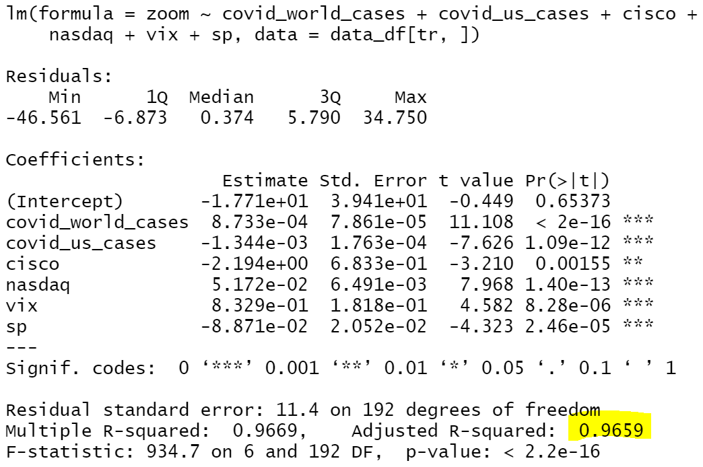
Forward, Backward, and Stepwise resulted in the same set of variables:
Covid Daily Cases - World
Covid Daily Cases - US
Vix
Cisco
Nasdaq
S&P 500
RMSE = 11.468
Adjusted R² = 0.9659
Notes:
Insight - Here, NASDAQ and S&P 500 show up as significant. This could be due to added complexity. Also, all three models give similar RMSE’s and R squares - this could be due to data and variable limitation

Slide 9
K - Nearest Neighbours

Slide 10
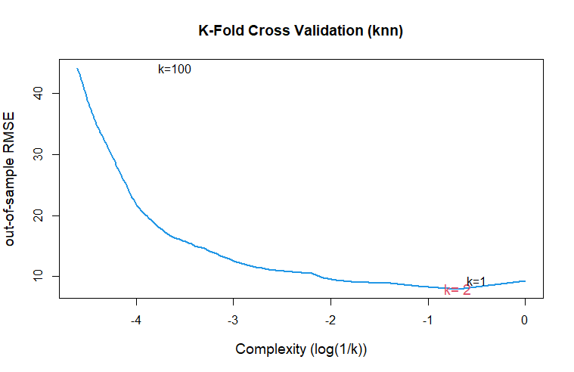
K Nearest Neighbours
We performed a 10-Fold Cross Validation on the dataset :
Variables from model selection
Covid_world_cases
Covid_us_cases
Cisco
nasdaq
Vix
S & P 500
The model chose k=2
RMSE = 7.96
Notes:
The indicators which were significant based on model selection, were then further used to create a Knn model. We used a KNN model with the K predictor between 1:100 and the model chose k=2, which is relatively small but it could be because of high stock volatility. Knn: a sample size of 100 among the 199 observations. The variables that were included in the knn model are covid_world_cases, covid_us_cases, cisco,nasdaq, vix, and sp. Based on the 10-fold cross validation, we arrived at the smallest RMSE when k=2, as can be seen in the graph.

Slide 11
Ridge & LASSO
Notes:
For variable selection, we did shrinkage methods by placing a constraint on the size of the estimated coefficients to reduce the variability of the estimates, which tend to get better predictions.

Slide 12
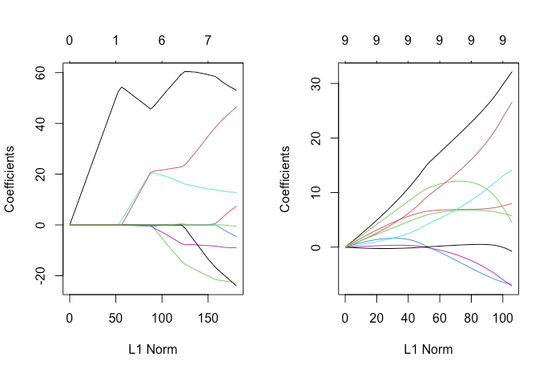
Ridge Regression
Variable Value
covid_world_cases 30.29558
covid_world_deaths 7.77842
covid_us_cases 6.66114
covid_us_deaths -6.57768
vix 13.33104
cisco -6.41714
sp -0.16895
nasdaq 24.56950
tsy_10yr_3mo_spread 6.09069
world covid cases
nasdaq
vix
Notes:
Significant predictors given by ridge regression are world covid cases, nasdaq, and vix.

Slide 13
LASSO
Variable Value
covid_world_cases 60.278085
covid_world_deaths .
covid_us_cases -16.981296
covid_us_deaths .
vix 15.538779
cisco -7.741839
sp -5.070269
nasdaq 26.959739
tsy_10yr_3mo_spread .
world covid cases
nasdaq
vix
US covid cases
Notes:
LASSO gave one more important variables, that is US daily cases. LASSO ends up with fewer features included in the model than we started with. Here we can see three predictors (world covid deaths, US covid deaths, treasury yield) have been dropped.

Slide 14
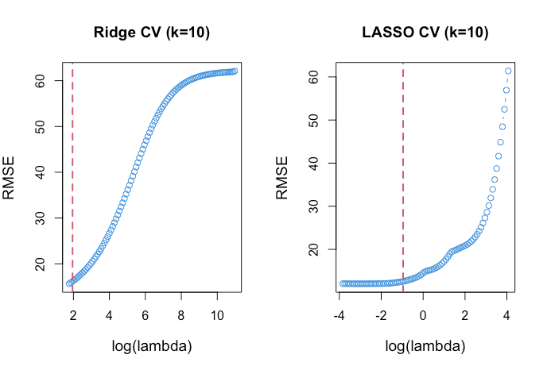
Comparing Ridge vs LASSO
Ridge
RMSE: 15.513
LASSO
RMSE: 11.893
Notes:
By comparing the out-of-sample performance of these two models, LASSO has a little bit lower RMSE than Ridge. This is because LASSO generally performs better when a relative small number of predictors have a strong effect in variable y. [world covid cases, vix, nasdaq -> Zoom price]

Slide 15
Tree Models

Slide 16
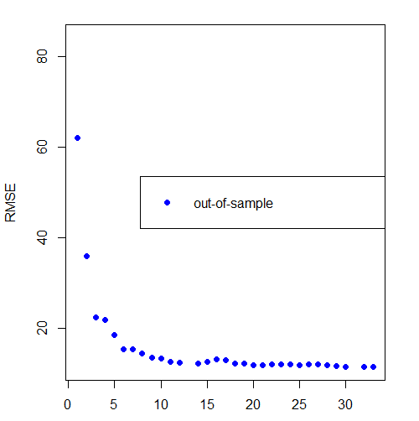
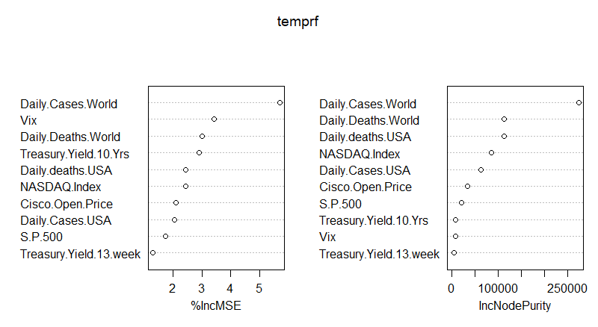
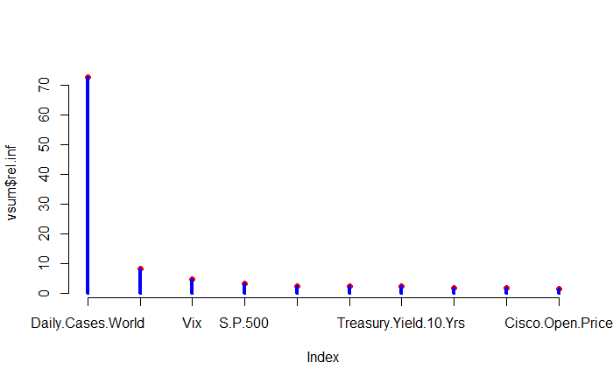
Decision Tree Models
Big Tree Regression
34 -> 33 nodes
RMSE: 11.29
Random Forest
4 variable split (m=4)
16 nodes
RMSE: 8.158
Boosting
2000 trees
6 nodes each
0.2 learning rate
RMSE: 9.286
Notes:
There are three models: big tree, random forest, and boosting. We use these models to predict the zoom opening price and they can be used for variable selection. First, we modeled all the predictors on a big tree regression model with 34 nodes, we then pruned (optimized) the tree to 33 nodes as it had the best out-of-sample RMSE at 11.29. We then wanted to improve on the model by using a random forest and cross-validation. We tested a random forest model on parameters m=p:sqrt(p) (p=num of predictors) and number of trees 10:100. Upon cross-validation testing, the best model used 4 variable split (m=4) and had a 16 node depth, resulting in an oos RMSE of 8.158. We used this model to test variable importance and daily world cases, NASDAQ, and daily US cases appeared to be the most important predictors. We then tried boosting to see if we could get even better. We tested the boosting model with parameters tree depth=4:16:2, number of trees = 1000:5000, and learning rates = 0.001,0.2. Comparing the resultant cross-validated out-of-sample RMSE, the best model was 2000, 6 node deep trees with a 0.2 learning rate, resulting in a oos RMSE of 9.286. In conclusion, these results show the random forest model as the best model for our purposes, this is likely because it naturally controlled for the number of predictors better than the other models.

Slide 17
Prediction

Slide 18
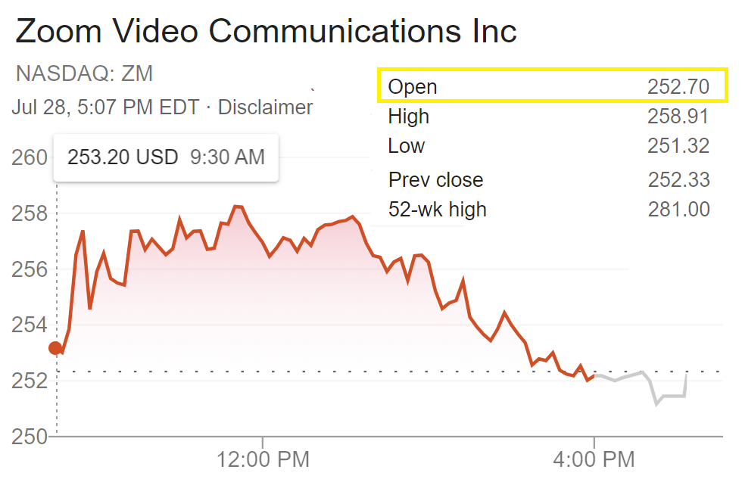
Predicting today’s opening price for Zoom!
Linear Regression - 296.61
Model selection: Forward, Backward, Stepwise - 298.89
Knn - 265.48
Ridge - 154.35
LASSO - 149.59
Tree Models (Tree, Random Forests, Boosting)
Tree: 272.59
Random Forest: 263.98
Boosting: 258.36

Slide 19
Conclusion

Slide 20
Summary
The best models to predict Zoom stock open price:
Models | Variables | RMSE
Simple Linear Regression | US covid cases | 15.22
KNN | World covid cases, US covid cases, Vix, Cisco, Nasdaq, S&P 500 | 7.96
Stepwise Search | World covid cases, US covid cases, Vix, Cisco, Nasdaq, S&P 500 | 11.47
Ridge | All | 15.51
LASSO | World covid cases, US covid cases, Vix, Cisco, Nasdaq, S&P 500 | 11.89
Decision Tree | World covid cases, US covid cases, Nasdaq, World covid deaths, US covid deaths | 8.16
Limitations:
We were restricted by Covid - 19 data, to just 200 entries -> may cause overfitting
There could be multicollinearity between predictor variables -> predictive power might be redundant
Notes:
For our data, KNN worked the best - this could be due to two reasons - one, the data size is limited, and two the number of parameters is much smaller than our training set. However, decision trees are a close second, and would perform even better with more data. LIMITATIONS : data set size could have caused overfitting and also there could have been an overlap between variables (for example - Vix, S&P and NASDAQ, which are all in some sense estimating the volatility of the market) - simple models might not capture those interactions. With that, we’d like to close this presentation - thank you!

Slide 21
Thank You!
Sources:
Stock Price: Yahoo Finance
https://finance.yahoo.com/quote/%5EIXIC?p=^IXIC
Daily confirmed COVID-19 cases (rolling 3-day average) https://ourworldindata.org/grapher/daily-covid-cases-3-day-average
Notes:
Thank you! Any questions?

